Slide 1

Project Audit Two
E-Asset Tracking
Alisha, Dillon, Franklin, Jordan, Rob and Woojin

Slide 2
Project Deliverables
Market Analysis
What is currently available on the market?
Can it be developed using COTS components?
Competitors in this area?
High-level system design
Requirements generation/analysis
Functional flow/breakdown
System/Subsystem interfaces
Operational prototype

Slide 3

Changes to the Project
Narrowed down the scope to Oil Rigs
Market Analysis Report
Main focus of the project
Preliminary Report completed this week
Final report to contain greater detail
Prototype
Scope has been narrowed down further to focus on an aspect of the market where there is a gap.
Prototype will be built and tested with the potential to add the findings of our testing to the report.

Slide 4
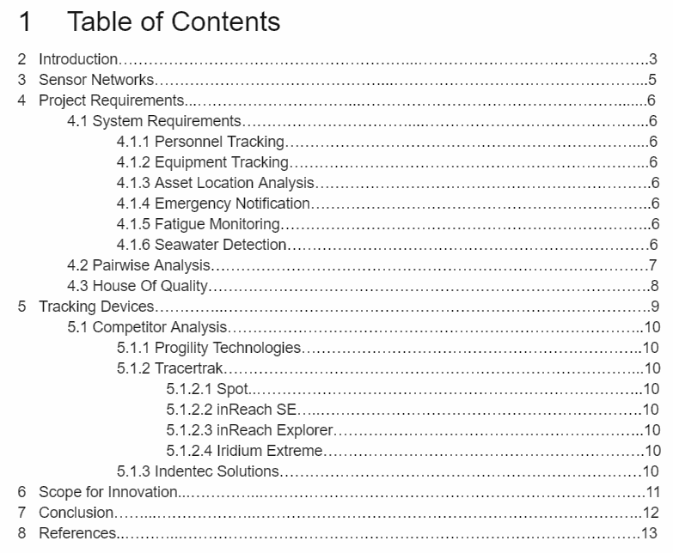
Action tasks since last audit
Preliminary report with Diagrams
All members
Planned prototype
Jordan
Managed drive
Rob
Prepared audit material
Rob
Updated GitHub landing page
Woojin
Table of Contents of the Preliminary Market Research Report

Slide 5
Communication
Team
Weekly team meetings: Wednesday 8-10am.
Slack communication.
Client
Weekly report to the client to update them on our progress.
Starting Week 5, upload Google Drive to GitHub on a weekly basis so the client can access our work.
Client meetings fortnightly.

Slide 6
Implementation of Feedback
Ways of receiving feedback
Observers (Meetings and Audits)
Tutors (Meetings and Audits)
Clients (Meetings, Audits and e-mails)
Team members (Meetings, Slack and Audits)
What we are doing to improve our project through feedback
Allocated time slot in our meetings to address feedback.
Understanding which pieces of feedback provide suggestions that can be useful to the project.
Changing the way in which we approach the project (new perspective)
Feedback is recorded on the Google Drive

Slide 7
Report Progress
Analysis of the challenges a tracking system in oil rigs possess.
Requirements breakdown .
Research into products and systems offered by competitors .
Scope for Innovation/Gaps in the market.
House of Quality Diagram
We submit the preliminary report to the client tomorrow.
Link to Report

Slide 8
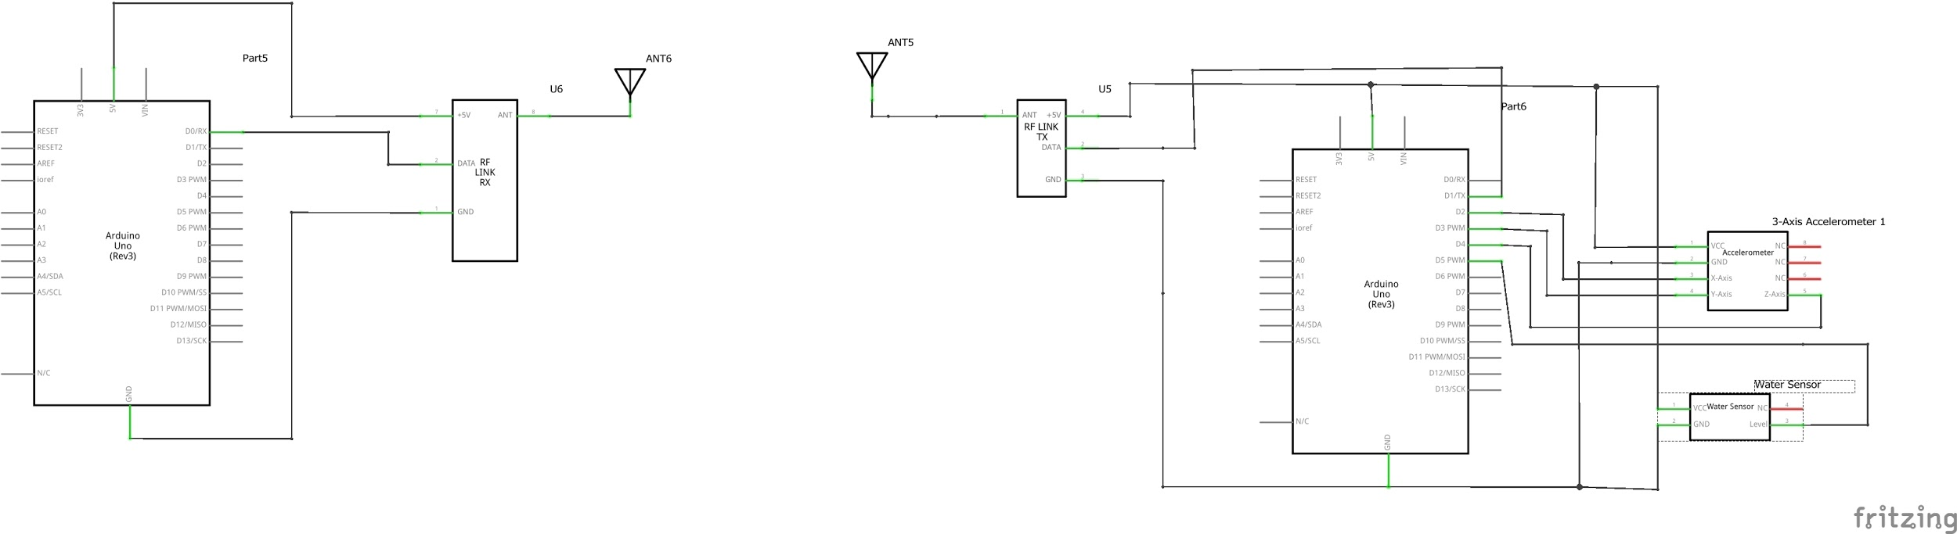
Prototype
Components - All parts have been ordered
2 x Arduino Uno
Arduino 3 Axis Accelerometer
Arduino Water/ Liquid Sensor Module
Battery
Wireless Transmitter
Wireless Receiver
Universal Pre-Punched Experimenters Board - Small
1/4 Watt Carbon Film Resistors -300 Pieces
Arduino 3 axis accelerometer

Slide 9
Prototype-Iterative Process
Iteration 1: Wireless transmitting and receiving
Use a basic transmitter and receiver module to validate path loss models and of the shelf product claims.
Iteration 2: Accelerometer
Add an accelerometer to the transmitter module to detect a fall .
Iteration 3: Water Sensor
Add a water sensor to detect a fall into the ocean.

Slide 10
Goals for next Audit + Showcase
Finish and submit final report to the client.
Complete a full system architecture.
Complete as many iterations of the prototype as possible.
Prepare for the audit and the showcase.
These tasks have been allocated amongst the team.

